Slide 1
Strategy Document Medbury Medical Services Division 2025

Slide 2
Executive summary
MMS is a Corporate Health & Wellness Business operates within the Workplace Wellness, Preventative and Personalized Medicine, Public Health, Healthy Nutrition & Weight Control sub-segments of the Global Wellness market.
It is an innovative approach to creating a bouquet of wellness solutions within a one-stop-shop which is targeted at meeting the multi-faceted corporate and individual health needs.
The market opportunity stems from
Need for corporates to facilitate their compliance with international and local HSE and Quality standards
Need for delivery of No 1 above in remote/ difficult terrains and conditions
Need to facilitate be-spoke post-screening specialized medical evaluation and interventions for clients e.g. Weight control
Need to solve customer experience and quality-related problems such as prolonged waiting time, TAT, medical errors, confidentiality and report delivery.
Need for all-in-one wellness hub that connects wellness-seeking clients with wellness providers
Overall target are to:
1. To build self-sustainable business units that drive Medbury's Corporate Health & Wellness leadership position in the Nigerian healthcare industry within 6 months
2. To grow current portfolio by 50% and create new product lines to achieve 50% new customer acquisitions per year.

Slide 3
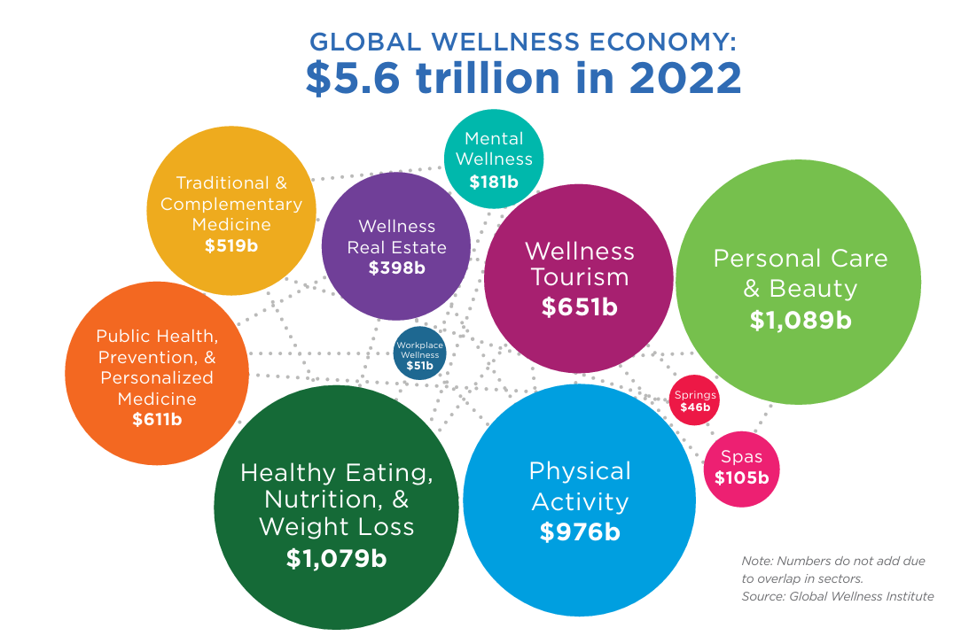
Market Size, Segmentation & Analysis-
The global corporate wellness solutions market estimated at $61.2 billion revenue in 2021
Is poised to reach $94.6 billion by 2026, growing at a CAGR of 9.1% from 2021 to 2026.
In a study of residents of 3 Nigerian states, 48.2% of those who had ever had a medical check-up did so frequently.
In a study of traders, 29.4% of males and 39.4% of females practiced periodic medical checkups.

Slide 4
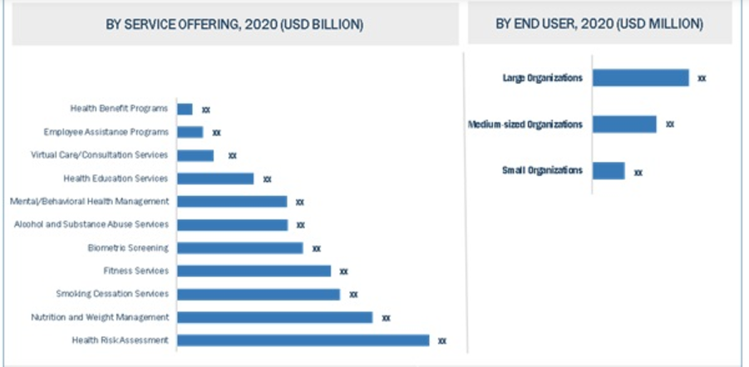
Market Size, Segmentation & Analysis-
By Service Offering
Health Risk Assessment
Nutrition and Weight Management
Smoking Cessation
Fitness Services
Biometric Screening
Alcohol/Substance Abuse Services
Mental/Behavioral Health Management
Virtual consultation/Virtual care
Employee Assistance Programs
Health Benefit Programs

Slide 5
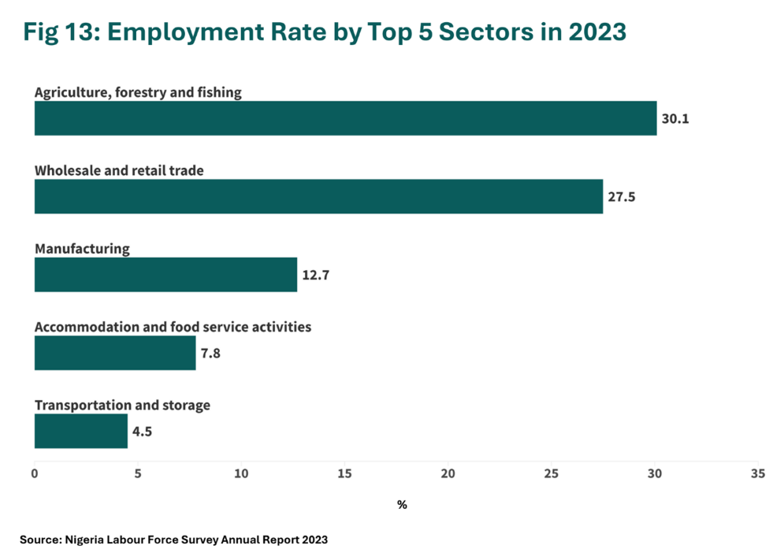
Market Size, Segmentation & Analysis-
The working population in Nigeria was projected at over 69.54 million in 2022
Manufacturing sector employs over 2.9 million persons. F & B accounts for 17% , Chemical & Pharmaceuticals 46% proportion
Revenue from OH was about N1.3b in 2023

Slide 6
Market Size, Segmentation & Analysis-
Top 10 Oil & Gas Coys
Lekoil Nig Ltd
Shell Nigeria
Chevron Nigeria
Exxon Mobil Nigeria
Ardova Plc
Addax Petroleum
Oando Plc
Cambridge Plc
Frontier oil
Con Oil
Top 10 Employers in Nigeria NBS for 2023
Dangote Cement Oil -19,073
UBA 10,007
FBN 8,773
Zenith 8,184
Access 7,334
Gtco 5477
Flour Mills 5,404
FCMB 3,554
Fidelity Bank 3,063
Nestle 2,375

Slide 7
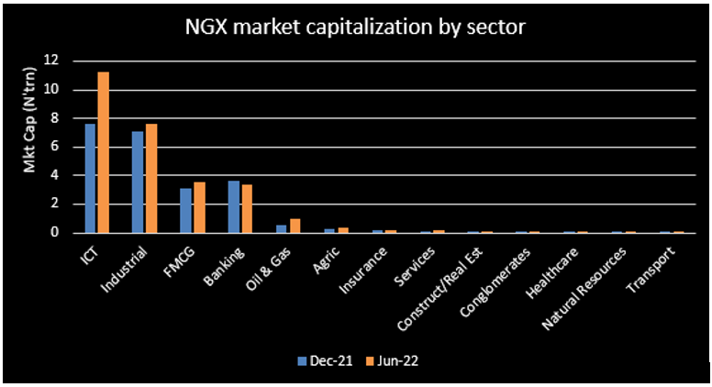
Most Valued Companies and Market Sector by Market Capitalization
S/N | COMPANY NAME | VALUE – Nov 2022 | INDUSTRY
1 | AIRTEL AFRICA | N5.4 trillion | TELCO
2 | Dangote Cement | N4.46 trillion | Manufacturing – Cement
3 | MTN Nigeria | N4.44 trillion | TELCO
4 | BUA Cement | N2.6 trillion | Manufacturing – Cement
5 | Nestle | $1.7 billion | Manufacturing – Food and Beverage
6 | BUA Foods | N1.1 trillion | Manufacturing – Food and Beverage
7 | Seplat Energy | $1.3 billion | Oil and Gas
8 | Zenith Bank | $1.5 billion | Banking and Finance
9 | GT Holdings | $1.3 billion | Banking and Finance
10 | Nigerian Breweries | $775 million | Manufacturing – Brewery
11 | Stanbic IBTC | $889 million | Banking and Finance
12 | Geregu Power | $731 million | Power
13 | Jumia | $457 million | Trade
INDUSTRY SECTOR | NO IN TOP13
TELCO | 2
Manufacturing – Cement | 2
Manufacturing – Food and Beverage : FMCG | 2
Manufacturing – Brewery | 1
Oil and Gas | 1
Banking and Finance | 3
Trade : Ecommerce | 1
Power | 1
Data at – Nov 22

Slide 8
Medbury Top Customers and Industry that accounts for 70% of Revenue
Industry | Number | Amount | Average
Food and Beverage | 5 | 131,765,961.28 | 26,353,192.26
Logistics | 2 | 40,578,223.82 | 20,289,111.91
Oiland Gas | 13 | 88,756,667.49 | 6,827,435.96
Telco | 1 | 9,197,259.34 | 9,197,259.34
Tobacco | 1 | 42,784,781.14 | 42,784,781.14

Slide 9
Medbury Top Customers and Industry that accounts for highest Revenue
OH recorded 1.32b in 2023 to 2024 June 2024
PH contributes to 63%, Lekki makes 34% and Ikeja 3%
Walk-in revenue was less than 5% of the Total revenue
Warri lifecheck commissioned in September 2024
Top 5 products sold are
Med-supplies 42%
Periodic Medicals (Annual Medicals) 18%
Pre-employment 17%
Food handlers Medicals - 13%
Chevron FFD 10%
Hospital Mgt is the most emerging product with SPDC IA Hospital
Pipelines growing – Oando, etc

Slide 10
Gap Analysis
EMR is not “yet” EMRing !
Not built to produce reports on frequency of purchase per product, only bundles.
Not built to run data analytics by charts etc
Dates formats are not flexible, combined day and date
Difficult to integrate with other systems
Admin end is not user friendly
Manuals for operation not provided
2. Multiple Price points to several clients manage orders, making bid response tedious and manual
Limited no of persons with basic knowledge and skill set occupational and travel health
Limited competence in procurement, supply-chain and bid management
Gap with Business Intelligence for product development and pricing
Multiple meetings impacting on productivity and effectiveness
Staff morale due to limitations in staff working conditions- Office space
QA gaps-Processes and procedures not followed leading to multiple errors and missed opportunities-
KPIs of first line managers not strong on P and L monitoring contributions
Gaps with soft skills among staff

Slide 11


ABOUT US
Our Vision
To become the first choice of holistic “wellness” care delivery in Nigeria.
Our Mission
To bring best-fit wellness solutions to individuals and corporates at their best time, in the best quality, and in the most profitable way.

Slide 12
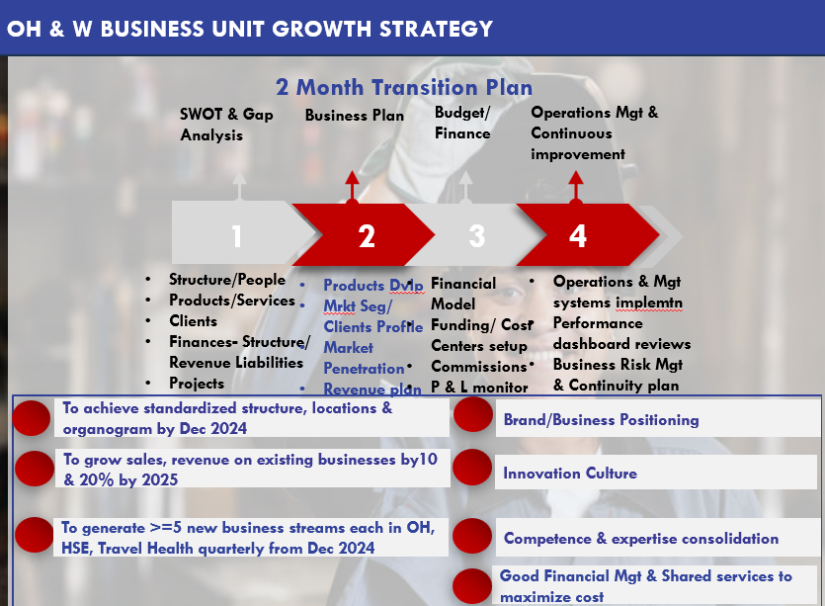
Corporate Health & Wellness Sub-Business Units

Slide 13
Corporate Health & Wellness Sub-Business Units
Lifecheck Wellness Centers-
Medfit (Occupational Heath Clinic)
Travel Clinic
Wellness Clinic
Medprojects
OHP, Med-advisory and Industrial Hygiene Product
Valuefit Safety Ltd
Med-supplies & CSR
Service Provider:
Med-Diagnostics

Slide 14
PRODUCT RANGE
Hospital/ Clinic Mgt

Slide 15
MEDFIT (OH Clinics)
Product Range | Target Market
Pre employment Medicals, Annual Medicals, Audiometry, Spirometry, Drug & Alcohol Testing & MRO Services | All corporate organizations, Oil and Gas, Banking and Finance, Manufacturing companies, Telcom companies
Offshore Medicals OEUK, Oil and Gas Company Medicals | Oil and gas Companies, EPCI (Engineering, Procurement, Construction, and Installation) , Drilling, Construction, Engineering, Logistics & Transport
Food handlers Medicals, domestic Staff Medical | Food and Beverage Companies,
Corporate & Individual Annual Wellness Packages, Pathology & Radiology Walk-in/ Retail Wellness Packages | HNW Individuals, Corporate Clients, Hospital/Doctor Referrals
Respiratory Fit testing, Work at height, Chemical Handlers | Specialized job roles from Manufacturing, Oil and Gas companies

Slide 16
HOSPITAL/ CLINIC MANAGEMENT -MEDSTAFFING
Product Range | Target Market
Occupational Health Nurse , Occupational Health Doctor Outsourcing | Large Manufacturing sites, Food and Beverage companies, Ports , Cement manufacturing
Offshore Medic Doctor, Offshore Medic Nurse, HSE Doctor Outsourcing | Oil and Gas FPSO companies, Drilling Companies
Medical Consultants Outsourcing | IOC : Oil and Gas companies
Clinic Staff Training | Large Manufacturing sites, Food and Beverage companies, Ports , Construction sites

Slide 17
HOSPITAL/ CLINIC MANAGEMENT- FULL MGT
Product Range | Target Market
Clinic Setup and Management, Inventory Managing | Oil & Gas Staff hospitals/ Clinics, Large Manufacturing sites, Food and Beverage companies, Ports , Construction sites
Hospital operations and management | Oil & Gas Staff hospitals/ Clinics, Large Manufacturing sites, Food and Beverage companies, Ports
EMR Services | Corporate clinics, Hospitals

Slide 18
MEDFIT
Product Range | Target Market
Pre employment Medicals, Annual Medicals, Audiometry, Spirometry, Drug & Alcohol Testing & MRO Services | All corporate organizations, Oil and Gas, Banking and Finance, Manufacturing companies, Telcom companies
Offshore Medicals OEUK, Oil and Gas Company Medicals | Oil and gas Companies, EPCI (Engineering, Procurement, Construction, and Installation) , Drilling, Construction, Engineering, Logistics & Transport
Food handlers Medicals, domestic Staff Medical | Food and Beverage Companies,
Corporate & Individual Annual Wellness Packages, Pathology & Radiology Walk-in/ Retail Wellness Packages | HNW Individuals, Corporate Clients, Hospital/Doctor Referrals
Respiratory Fit testing, Work at height, Chemical Handlers | Specialized job roles from Manufacturing, Oil and Gas companies

Slide 19
OHP, INDUSTRIAL HYGIENE, MEDADVISORY SERVICES
Product Range | Target Market
Needs Assessment, Preventative Health programs | All HNW Corporate organizations – Banks, Oil & Gas, Food & Beverage, Manufacturing
Ergonomic Survey | All HNW Corporate organizations – Banks, Oil & Gas, Food & Beverage, Manufacturing,
Air Quality Testing | Manufacturing, Construction companies, Oil and Gas
Noise Mapping and Survey | High Noise Frequency Generating companies – Manufacturing, Oil and Gas Food and Beverage Factory/Production sites
Health Risk Assessment, Microbiological Audit | Oil Mining Onshore and Offshore Sites – Oil

Slide 20
Occupational Health Service Line : MEDSUSTAIN / CSR
Product Range | Target Market
Awareness Campaign and testing : Malaria, HIV , Mental Health | Large Oil and Gas Companies , Manufacturing Companies , Telco, Tier 1 and 2 Banks
Preventive interventions : Malaria Fumigation , Cervical Cancer Screening | Large Oil and Gas Companies , Manufacturing Companies , Telco, Tier 1 and 2 Banks
Behavioural change campaigns, Advocacy, Policy formulation | NGOs, PPPs, Corporates

Slide 21
WELLNESS PRODUCTS
Product Range | Target Market
Comprehensive Health Assessments, fertility tests, Pre-marital health screening, | Corporates, HNWs, Individuals, Women, Domestic Workers, New Couples etc
IV Micronutrient therapy for general wellness (recovery, immune boosters, skin, nails, hair hydration etc) | Celebrities, HNWs, Beauty enthusiasts, Beauticians , influencers
IV Micronutrient therapy for Weight loss e.g. Slimboosts 10 sessions to loose 8 to 10kg. L Carnitine, MIC & Cynanocobalamin (Vit B12) , Pre-Detox | Celebrities, HNWs, Beauty enthusiasts, Beauticians . influencers
Diet Meal plans, Weight loss pharmacological interventions eg Mounjaro | Chronic illness patients, Obese patients, Dieticians, Hospitals, Beauticians, Celebrities, HNWs, Beauty enthusiasts, Beauticians
Non-invasive liposuction services | Celebrities, HNWs, Beauty enthusiasts, Beauticians . influencers

Slide 22
Five Forces Analysis : MEDFIT
New Entry
Substitution
Supplier
Buyer
Competitive Rivalry
Three major factors cause the barrier of entry:
Policies and regulations from both the government and the health regulatory agencies.
The high cost of establishing the new clinic.
Absence of economies of scale of the existing industry players
Substitute products exist and are in demand to the degree to which customers are aware of them.
Substitute Products to Medical Fitness Assessment is Laboratory testing and Doctor Consultation used to Medical Fitness
Suppliers’ power is high due to the current high Dollar to Naira exchange rate.
This will impact on the cost of our products and services
Buyers are more sophisticated and need demand higher quality of service. They are also more willing to pay premium prices for excellent services
Providing High Quality services at premium prices will generate better revenue
After the success with Covid testing , Medbury has attracted a lot of rivalry.
The rivalry is driven by price competition, advertising battles.
Medbury need to focus on excellent KAM to retain market share and grow client base.

Slide 23
Five Forces Analysis : HOSPITAL/ CLINIC MGT
New Entry
Substitution
Supplier
Buyer
Competitive Rivalry
Three major factors cause the barrier of entry:
Moderate barrier of entry into Medical Staff Outsourcing.
There is not special requirement apart from registration as a healthcare facility , qualification of medical personnel to enter market, registration will DPR and Nipex
Strong regulations and policy will create higher barrier of entry
Substitute products exist and are in demand to the degree to which customers are aware of them.
Substitute products is direct recruitment by companies
Medbury has to provide more value in clinical and operational governance to encourage adoption instead of direct hire
Supplier are Doctors and Nurses engaged to provide these services .
High rate of immigration to other countries has made them scarce and therefore more expensive to engage.
This high cost of medical personnel will impact on profit margin and prices
The buyers are clients who are usually Tier 1 Large manufacturing companies and Oil and gas companies
There are several healthcare companies that provide medical staff and clinic management services e.g Lagoon hospital, Isos, sims, ambulance NG etc.
The competition is getting tougher with shrinking viable market and more new entrants

Slide 24
Five Forces Analysis : MEDPROJECT
New Entry
Substitution
Supplier
Buyer
Competitive Rivalry
Barriers to entry of new entrants are as follows
Capital investment in purchase of equipment such as Audiometers and Spirometers
Large project management capacity
For small scale medprojects lots of healthcare prioviders can do it, so we need to focus on the large projects with specialized requirements
Substitute products exist and are in demand to the degree to which customers are aware of them.
Substitute products is having a provider clinic come on site and collect samples to do testing
Supplier are consumables suppliers , Logistics support, medical personnel.
Price negotiation and fixing with extended payment time will improve cash flow and profit.
Keeping loyalty of contract staff will help keep quality
The buyers are clients who are usually Tier 1 Large manufacturing companies and Oil and gas companies
There are several healthcare companies that provide medical staff and clinic management services e.g Lagoon hospital, Isos, sims, ambulance NG etc.
The competition is getting tougher with shrinking viable market and more new entrants

Slide 25
Five Forces Analysis : MEDADVISORY
New Entry
Substitution
Supplier
Buyer
Competitive Rivalry
The barrier to entry is low but it requires a vast knowledge, communication skills and flexibility
Substitute Product is the retainer doctor, Company Legal who can provide opinion on how to manage medicals issues
Supplier is Medical Advisor and the Consultant third party Vendors.
The supplier market is also very limited and this means we need to pay premium to enage them
Buyers are Tier 1 Manufacturing and oil and gas companies who due to regulatory requirement have to engage qualified Occupational Health Physicians
The rivalry is driven by price competition, advertising battles, product
introductions and increased customer service or warranties

Slide 26
Five Forces Analysis : MEDSUSTAIN / CSR
New Entry
Substitution
Supplier
Buyer
Competitive Rivalry
The barrier to entry is low
Many healthcare organizations provide CSR services to corporate and non governmental organizations
Event management and project management skill is a required
No regulation guiding the provison of CSR
Substitute Product is the direct donation of supplies to the recipient community
Supplier are the vendors of the consumables used for the CSR.
Supplier power is low as alternative vendors and products abound
Buyers are Tier 1 and 2 Manufacturing, banking, telco and oil and gas companies who want to provide CSR to the host community , subscribers or customers.
The rivalry is driven by price competition , competence and past records of successful execution.
NGO also provide this services
Competitive Rivalry is low because the market is currently unsaturated

Slide 27
Business Objectives MEDFIT- LIFECHECK WELLNESS CENTERS
To attain No 1 position in Occupational Health & Wellness Company in Nigeria by end of 2025.
Market Share
To achieve 10% average month-on-month sales growth in pre-paid product sales & 5% corporate product sales
Increased Sales
To achieve 35% increase in product lines and 20% in revenue BY end of 2025.
Revenue Growth
Customer Acquisition
To achieve acquisition population inclusive of 40% of new, 50% renewals & 10% reactivations by end of 2025
To achieve a standardized structural design & Blue-print for medium & large scale Lifecheck Wellness Centers within 6
Capacity Development

Slide 28
Business Objectives ; HOSPITAL/CLINIC MGT
To achieve market dominance in provision of high quality and clinic mgt
Market Share
To achieve 10% month-on-month sales growth across revenue lines.
Increased Sales
To increase the revenue by 20% by year end 2025
Revenue Growth
Customer Acquisition
To grow the client base from by 50% by end of 2025
To develop local capacity in Specialist Hospital Operations
Capacity Development

Slide 29
Business Objectives ; MEDPROJECT
To attain No 1 position in the provision of high quality Onsite Medical Assessment
Market Share
To achieve 10% month-on-month sales growth across revenue lines.
Increased Sales
To increase the revenue by 20% by year end 2025
Revenue Growth
Customer Acquisition
To grow the client base from by 50% by end of 2025
To develop own infrastructure & Team for mobile clinic / onsite medical assessment across Nigeria
Capacity Development

Slide 30
Business Objectives ; MEDADVISORY
To attain No 1 position in the Occupational Health Consultancy industry
Market Share
To achieve 10% growth across Medadvisory revenue lines by end of 2025
Increased Sales
To increase the revenue by 20% by year end 2025
Revenue Growth
Customer Acquisition
To grow the client base from by 50% by end of 2025
Capacity Development
To develop a consultancy product and team within 6 months

Slide 31
Business Objectives ; MEDSUSTAIN / CSR
To attain No 1 position as CSR project implementation partners across Nigeria by end of 2025
Market Share
Increased Sales
To achieve 10% month-on-month sales growth across revenue lines.
To increase the revenue by 20% by year end 2025
Revenue Growth
Customer Acquisition
To achieve acquisition population inclusive of 40% of new, 50% renewals & 10% reactivations by end of 2025
Capacity Development
To develop Project Mgt and P and L monitoring capacity team by end of Q2 2025

Slide 32
MEDFIT– SWOT Analysis
Strengths
Weaknesses
Over 400 client company foot prints
Accredited and approved by most IOC for Medical Fitness – Shell, Exxonmobil, Chevron
4 Prime locations in Lekki, Ikeja, Portharcourt and Warri
Technical Internationally trainedand reputable Occupational Medicine Expertise – Dr Lanre Ajayi
Experienced Onsite project team
Procurement and Sales Skill-set and competence limited
Staff retention capacity is weak
Not enough Occupational Health Specialists on Team
Limited areas of specialization, leading to outsourcing
S
W
Opportunities
Threats
Growing opportunities for retail business in all lifecheck locations
Growing demand for Wellness services in Nigeria
Reverse Medical tourism and Migration
Competitors & new entrants into the market
Clinalancet , CIMS, AmbulanceNG
Japa syndrom
O
T

Slide 33
HOSPITAL & CLINIC MGT – SWOT Analysis
Strengths
Weaknesses
Experience with clinic mgt in onshore and offshore settings
Partnership with international multi-specialist hospital mg company Alameda
Good technical support
Brand reputation
Limited procurement and bidding expertise
Weak capacity to leverage on economies of scale
S
W
Opportunities
Threats
Offshore rigs staffing for IOCS
Improved IT driven clinic mgt model
Clinical Governance models
Hospital Staff Trainings & Accreditations preparations
Volatility of Forex posing risk of cost hike
Economic inflation driving budget cut -down
Direct Hiring of Medics by Companies
O
T

Slide 34
MEDADVISORY – SWOT Analysis
Strengths
Weaknesses
Unique value proposition
Industry experience
OH Specialist support – Dr Lanre
Limited procurement and bidding expertise
Limitation in skill set for communicating value proposition
S
W
Opportunities
Threats
Outsourcing Medadvisor to IOCS and Major Manufacturing firms
Providing Medadvisory services to large conglomerate
Industrial Hygiene services Specialization
Direct Hiring by Companies
QHSE Managers
Company doctors
O
T

Slide 35
MEDSUSTAIN / CSR – SWOT Analysis
Strengths
Weaknesses
Brand Recognition
Substantial experience and Significant Foot-prints for same service
Project management competence
Client loyalty
Use of 3rd party vendors for event planning and setup
No dedicated CSR sales team and product development / specialization
S
W
Opportunities
Threats
Large pan Nigerian CSR project
Collaboration with NGO and Government to provide CSR to states
NGO
Sociocultural perculiarities
Health Regulatory bodies
O
T

Slide 36
SWOT Analysis
Strengths
Weaknesses
Brand Recognition
Substantial experience and Significant Foot-prints for same service
Project management competence
Client loyalty
Use of 3rd party vendors for event planning and setup
No dedicated CSR sales team and product development / specialization
S
W
Opportunities
Threats
Large pan Nigerian CSR project
Collaboration with NGO and Government to provide CSR to states
NGO
Sociocultural perculiarities
Health Regulatory bodies
O
T

Slide 37








The Business Model for Lifecheck Wellness Centers
Key Activities
Key Partners
Value Proposition
Customer Relationships
Customer Segments
OH, Migration Health Diagnostic screening service Doctors Consultation & review pre & post screening
Wellness Services Counselling (Virtual & Physical)
Sales of Wellness & fitness products (e.g. Supplements, Meal plans, Occupational therapy devices)
Customer service
Regulatory Bodies : HEFAMMA
Associations : SOEPHON
Embassies
FMOH
SMOH
Internatl Accred. Org
One-stop shop
Excellent Customer Service
Monthly Webinars (Family, Employees)
Online Appointment Booking & Reports
Prompt Turn Around Time
Medical Recommendation and Reliable Fitness Decision
Personalized post-screening solutions within
Client Support Service
Excellent customer service
Technology-enabled decision-making
Oil and Gas companies
Walk in Clients
Oil and Gas Contractors
Manufacturing Companies
Banking and Finance
Corporate Organizations
Telco
Channels
Key Resources
Company reps (HR, CMDs)
Brokers
Travel, Marketing Agencies
Mobile App of Corporates
Website, Social Media
Associations/ Sponsorships
Of Weight control programs & Travel programs
Integrated EMR
Strong Cash Flow to run operations
Occupational Health Physicians
Panel Physicians
Cost Structure
Revenue Streams
Direct Staff
Indirect cost
Standardization of prices
Medical Assessment fees for Corporate Clients
Migration health assessments fees
Walk in Wellness Screening and therapeutic charges
Wellness product Sales
Partnership with Wellness Specialist Service providers
Subscriptions to Medfit tech to corporates

Slide 38
Operational Model
Organogram
Clinical Governance and Case Review

Slide 39
The Operations Strategy for Corporate Health & Wellness
People & culture
Processes & Procedures
Tools
Business Development
Clinic Governance
Infrastructure
Location
High human traffic Areas
Standardized floor plans (Small –Outposts Medium, Large)
Car parking space –>= 10 cars
Reception
Dual Waiting area. Biometrics/ Tallies
Solfas mixed with Plastic seats
Front Desk
Furniture & Interior décor blue-print
Guest Relations/ Customer Experience Desk
Multimedia display of Wellness packages & [products
Organogram display
As per scale
Job Descriptions & KPIs
Training & On-boarding
Smart Uniforms
Front Desk, All Medical Staff
Training
Annual, Quarterly, E-learning (Learning plan)
Performance monitoring & mgt
Daily, Weekly, Quarterly, Yearly with bonuses
Fatigue Mgt programs
Leave Plans, Staggered breaks
Staff Welfare improvement
Office working conditions
Sales targets for each Lifecheck center
Guest Relations/ Customer Service agents responsible for Upselling & Cross selling
Medlinkr App reactivation
Complimentary services
Continuous Improvement committees (QI, Optimization etc)
Fixed update meeting days /week
Fixed client engagement meetings (Physical and Virtual
Fixed coaching, training and support meeting days
Fixed in-clinic product drive days
SOPs & protocols
Updates, Alignment & Display
Training & Compliance
Assign role dedicated staff
Quality Control checks daily, weekly, monthly
Documentation, Records & archiving
Assign role dedicated staff
Customer Service
Create Customer Service Desk per location with central coordinator
Customer feedback & complaints handling
Laptop Computers
Tablets for Guest Relations
Finger-print scanners for Biometrics
Queue Mgt and tally systems
EMR
With capacity for details of data capturing and analytics required

Slide 40
Hospital Mgt – The Business Model for Clinic Management
Key Activities
Key Partners
Value Proposition
Customer Relationships
Customer Segments
Full Clinic Mgt
Industrial Clinic Staffing
Diagnostics & Pharma unit mgt
Industrial Clinic staff supervision and management
Emergency Services provision
Equipment and Drugs Supplies & inventory management
Referral and Case management
Human Resource Managers : HR of client company
Procurement Manager of Client companies
Medical Advisors
GPs Divisions
Operations & Mgt Systems
Access to World-class hospital mgt provider partnerships
Highly qualified staff
Clinical Activities Over sight
Key Account Management KAM
Monthly reporting
Tier 1 Manufacturing
Tier 2 Oil and Gas
Banks and financial institutions
Maritime coys
Channels
Key Resources
Industry partners Referral
Existing Corporate Companies
Lead generation and marketing
Sales Marketing through proposals
Well qualified and training medical staff
Clinical Governance system
Cost Structure
Revenue Streams
Clinic set-up contracts
Capitation model payments
Fee for Service payments
Clinic staffing and service charges
Clinic management fees
Pharmaceuticals & Diagnostics Outfit mgt
Direct staff cost
Indirect – Operations cost

Slide 41
MedProject – The Business Model for Onsite Medical Assessment Project
Key Activities
Key Partners
Value Proposition
Customer Relationships
Customer Segments
Consumables supplier
Client medical representatives
FMOH
Excellent Key Account Management
Convenient onsite Medical Assessment for staff
All reports in one place EMR
Analysis of reports
Occupational Health Aligned Fitness Decision
Follow up and mop up
Onsite medical assessment of employees
Project management
Collation of laboratory and clinical findings
Uploading on EMR
Presentation of summary report
Tier 1 and 2 Food and Beverage companies
Tier 1 Cement companies
Tier 1 and 2 Banks
Channels
Key Resources
Digital Marketing Agency
Mobile App
Website
Social Media
Conference Sponsorship
Vencor partners
Project team
Project supervisor
EMR
Finance
Cost Structure
Revenue Streams
Purchase Order for consumables
Direct cost of personnel
Indirect cost of logistics ,accommodation etc
Onsite Medical Testing Project Fees

Slide 42
MedAdvisory – The Business Model for Medical Advisory and Occupational Hygiene
Key Activities
Key Partners
Value Proposition
Customer Relationships
Customer Segments
Needs Analysis engagements
Corporate Medical Advice/ Reports
Occupational Hygiene Measurements
Health risk assessments
OHP services
MRO Services
Medical Training Services
3rd Party Vendors –
SOEPHON
Consultancy services of Occ hygiene service provider
Professional Medical Advise
Health Promotion Program Management
HMO Selection and management
Excellent technical support
Case Advisory
Tier 1 – Oil and Gas
Tier 1 and 2 – Manufacturing Companies
Corporate Organizations – Banking, Telco Etc
Channels
Key Resources
Digital Marketing Agency
Website
Social Media
Referral
Proposal Submission
Occupational Health Specialist
Medical Advisor
Industrial Hygiene specialist
Cost Structure
Revenue Streams
Monthly Charge for Medadvisory Services
Contract fee per project
Consultancy fees
OHP retainership sharges
Monthly Salary of Medadvisor
3rd Party Consultant Fees per project

Slide 43
MedSustain – The Business Model for Medsustain / CSR
Key Activities
Key Partners
Value Proposition
Customer Relationships
Customer Segments
HMO
NGO
Action groups
Effective community outreach
Great media coverage and publicity
Post impact assessment
Wide reaching impact
CSR managers for corporate organizations
Excellent KAM
Mobilization of local community / attendees
Project Management of event
Media Coverage
Post impact assessment and reporting
Tier 1 – Oil and Gas
Tier 1 and 2 – Manufacturing Companies ,
Corporate Organizations – Banking, Telco Etc
Channels
Key Resources
Digital Marketing Agency
Website
Social Media
Referral
Proposal Submission
Event Planner
Project manager
Logistics support
Speakers / Material Productions
Media Support
Cost Structure
Revenue Streams
Consumables and IEC materials cost
Logistics cost
Speakers cost
CSR Mobilization and implementation fees

Slide 44
– The Business Model for Medsustain / CSR
Key Activities
Key Partners
Value Proposition
Customer Relationships
Customer Segments
HMO
NGO
Action groups
Effective community outreach
Great media coverage and publicity
Post impact assessment
Wide reaching impact
CSR managers for corporate organizations
Excellent KAM
Mobilization of local community / attendees
Project Management of event
Media Coverage
Post impact assessment and reporting
Tier 1 – Oil and Gas
Tier 1 and 2 – Manufacturing Companies ,
Corporate Organizations – Banking, Telco Etc
Channels
Key Resources
Digital Marketing Agency
Website
Social Media
Referral
Proposal Submission
Event Planner
Project manager
Logistics support
Speakers / Material Productions
Media Support
Cost Structure
Revenue Streams
Consumables and IEC materials cost
Logistics cost
Speakers cost
CSR Mobilization and implementation fees

Slide 45
Competitor Analysis:
 | Medbury | ISOS | Mecure | CIMS
Overview | Medbury is the first dedicated Corporate Health Advisory & Management company which provides assistance to organizations that enables them achieve their Workplace Health and Wellness goals. This create a special access to corporate organizations. Medbury provides a holistic end-to-end service that covers all health needs within the workplace, and it is a one-stop shop for all the clients’ healthcare needs | Isos deliver international standards of healthcare and emergency medical assistance to the wider expatriate community and international organizations in the region. Its purpose was to provide clients with access to local assistance services, clinics, centers of medical excellence, and evacuations when needed | Mecure is a diagnostic company and since have ventured into eye-care, dental care, cancer management and preventive healthcare
Products & Services | Medical Supplies (Consumables & Equipment), Medical Fitness Solution, Emergency Response Service, Medical Staffing, Health & Safety Training | 27 Assistance Centres - 6,000 Medical Professionals -. Access to 3,200 Security Specialists -. 53 Clinics and over 1,000 Remote and Workplace Sites 103,000 Accredited Providers - In healthcare, aviation and security. | Laboratory testing - individual and Corporate Medical Imaging – CT, MRI, Uss, DNA Testing Cardiac testing Dental Eye Screening
Competitive Advantage | Brand reputation, Wide reach across the geopolitical zones in Nigeria, robust technology | Air Ambulance , International Brand, International accreditation, cross continent expertise , 27 Assistance Call center | MRI, CT Scan, Massive Facility with capacity for large footfall
Target Market | Corporate Institutions, Government & Its Agencies, Hospitals & Pharmacies | Oil and Gas companies, Government | Individuals, Corporates,
Partnerships | Local & International | International | Local
Marketing Strategies | Advertisement & promotions, Social Media, CSR, Cost reduction through economies of scale | Global market entry, referral , Bidding | Online presence, Social media, Bundle discount, wellness packages
Technology Leverage | Online ordering channels, customer support (Web Chat, WhatsApp), Inventory Management System, Mobile App (MedburyLabs) | Proprietary EMR software and Clinic management software | EMR , LMS, Robust website
Pricing | Competitive | Premium | Low pricing and premium
Distribution Channels | Vast and spread across the geopolitical zones of Nigeria | Global Distribution | Pan Nigerian,

Slide 46
MEDFIT - Unique Selling Points
Key Success Factors
State-of-the-Art Technology
EMR
Good Quality Service
Wider Spread of Branches
Marketing Strategy
Approved and Audits
Competitive Pricing

Slide 47
HOSPITAL MGT - Unique Selling Points
Key Success Factors
State-of-the-Art Technology
World-class Clinical Governance
Trained and Competent Staff
Marketing Strategy
Brand Reputation & Loyalty
Competitive Pricing

Slide 48
MEDPROJECT - Unique Selling Points
Key Success Factors
State-of-the-Art Technology
EMR
Convenient Service
Mobile Project Team
Marketing Strategy
Brand Reputation & Loyalty
Competitive Pricing

Slide 49
MEDADVISORY - Unique Selling Points
Key Success Factors
Advisory Database
Unique Value proposition
Specialization
Marketing Strategy
Brand Reputation & Loyalty
Competitive Pricing

Slide 50
MEDSUSTAIN - Unique Selling Points
Key Success Factors
National Coverage
Unique Value proposition
Specialization
Marketing Strategy
Brand Reputation & Loyalty
Premium Pricing

Slide 51
MEDFIT - Marketing &Sales Plan
Customer Segment | Target Tiers | Channel Partners | Online Strategy | Offline Strategy/PR | Pricing Strategy | Sales Strategy
Oil and Gas companies | Tier 1 , 2 and 3 | HSE manager, HR and Procurement | Newsletters and social media lead generation | Oil and Gas conference sponsorship | Premium Pricing | Sell through Network and referral
Corporate Organization | Tier 1 and 2 | HSE manager, HR and Procurement | Website, Webinars for Clients , | Join Associations and sponsor HR programs | Competitive Pricing , Low pricing for market entry | Direct selling , HMO referral

Slide 52
HOSPITAL MGT - Marketing &Sales Plan
Customer Segment | Target Tiers | Channel Partners | Online Strategy | Offline Strategy/PR | Pricing Strategy | Sales Strategy
Manufacturing Companies | Tier 1 and Tier 2 | HMO, HR Associations | Website, email Marketing, Webinars for Prospective leads , | Sponsorship of Conferences | Competitive Pricing | Proposal and Presentation to Leads
Oil and Gas | Tier 1 and Tier 2 | NIPEX, DPR, NOG forum | Website, email marketing | Sponsorship of Conferences | Premium Pricing | Proposal and Presentation to Leads Client referrals

Slide 53
MEDPROJECT - Marketing &Sales Plan
Customer Segment | Target Tiers | Channel Partners | Online Strategy | Offline Strategy/PR | Pricing Strategy | Sales Strategy
Manufacturing Companies | Tier 1 and Tier 2 | HMO, HR Associations | Website, email Marketing, Webinars for Prospective leads , | Sponsorship of Conferences | Competitive Pricing | Proposal and Presentation to Leads
Oil and Gas | Tier 1 and Tier 2 | NIPEX, DPR, NOG forum | Website, email marketing | Sponsorship of Conferences | Premium Pricing | Proposal and Presentation to Leads Client referrals
Banks and Financial Institutions | Tier 1 and 2 | HMO, Sales Reps | Website and email marketing | Attending and presentation at Association meeting | Competitive Pricing, Large volume discounts | Value proposition proposals

Slide 54
MEDADVISORY - Marketing &Sales Plan
Customer Segment | Target Tiers | Channel Partners | Online Strategy | Offline Strategy/PR | Pricing Strategy | Sales Strategy
Manufacturing Companies | Tier 1 and 2 | HMO, HR Associations, Procurement Team | Website, email Marketing, Webinars for Prospective leads , | Sponsorship of Conferences | Competitive Pricing | Proposal and Presentation to Leads
Oil and Gas | Tier 1 and Tier 2 | NIPEX, DPR, NOG forum | Website, email marketing | Sponsorship of Conferences | Premium Pricing | Industrial Hygiene Value proposition

Slide 55
Financial projections-Wellness products

Slide 56


Balanced Scorecard for Medbury Medical Services-Corporate Health & Wellness

Slide 57
Financial Perspective
Objective: To diversify and grow revenue streams to achieve financial sustainability through innovative product and customer base expansion.
Strategic Objective | Priorities | KPIs | Strategic Initiatives
Product diversification | - Develop premium, high-demand, value-based life-style & wellness products | - 20% growth in annual revenue (New and existing products) | - Hire technical partners and staff to assure revenue-magnet products
Increase profits | - Price standardization | - 40% Gross profit margin | - Optimize product pricing strategies
Reduce operational costs | - Build cost leadership culture in operation | - 40% Cost-to-sales ratio | - Implement cost management techniques and tools (eg Customer profiling, Profitability Based Sales Drive)
Improve cash flow | - Develop culture of cash flow monitoring | - At least 98% of invoices submitted within 72hrs of job completion. | - Implement cash flow monitoring tools (Monthly statement, Working Capital)

Slide 58
Customer Perspective Objective: To build excellent services and centers where we offer personalized customer experiences that exceed expectation
Strategic Objective | Priorities | KPIs | Strategic Initiatives
Promote brand loyalty | - Build customer-centeric services & centers | -70% Customer retention rate | - Implement a System and CRM to track customer engagement and retention performance
Enhance customer TAT | - Attain best TAT in the industry | - 85% Customer satisfaction score (CSAT) | - Optimize SOPs, SLAs and internal set-up to facilitate service delivery & communication
Customer empowerment | - Improve customer participation in service delivery | - 30% score in customer participation in surveys & forums | - Introduce customer engagement forums (pod-casts), platforms & events
New customer acquisition | - Diversification of products | - 30% growth in new customers/business | - Create and grow retail products and services

Slide 59
Internal Processes Perspective
Objective: Streamline internal operations to ensure efficiency, compliance, and product excellence.
Strategic Objective | Priorities | KPIs | Strategic Initiatives
Optimize production efficiency | - Achieve at least 98% TAT compliance | - Production efficiency rate | - Invest in EMR upgrade and automation of processes and SLAs
Ensure product quality | - Maintain stringent quality controls | - % defect-free products | - Regular quality audits and employee training
Strengthen supply chain management | - Minimize delivery lead times | - On-time delivery rate | - Implement a robust supply chain ERP
Enhance regulatory compliance | - Adhere to global and local standards | - Compliance score | - Conduct regular regulatory reviews

Slide 60
Revenue Strategy –Lifecheck Wellness Centers
Restructuring of Lifecheck centers to Screening and Wellness mini-hub
Innovatively introduce products that attract pre-payment and up-front payment by corporates –Retail wellness products, subscriptions (Medbury App, Weight control programs)
Ramp up marketing for Travel health products and services for non-regulated embassies and chase other Migration 5 Health Working group countries for accreditation
Create revenue generation targets for each Lifecheck center CM, ACMs and Customer Service team members (including project)
Create partnerships with Wellness experts, Consultants/ Doctors in private hospitals with incentives for referrals for diagnostics/ screenings
Partner with Wellness product and Occupational therapy merchants for Sales commissions/
Create Add-ons for some Lifecheck screening products
Select strategic staff for training in certifications in order to begin to develop own expertise for Occupational health, ISO and Emregency certifications

Slide 61
Corporate Health & Wellness organogram

